Slide 1
Quantum Fourier Transform
(QFT)
Aidan Westphal, James Bialas, Yi Hung Lim

Slide 2
1
Classical Fourier Transform
James Bialas

Slide 3
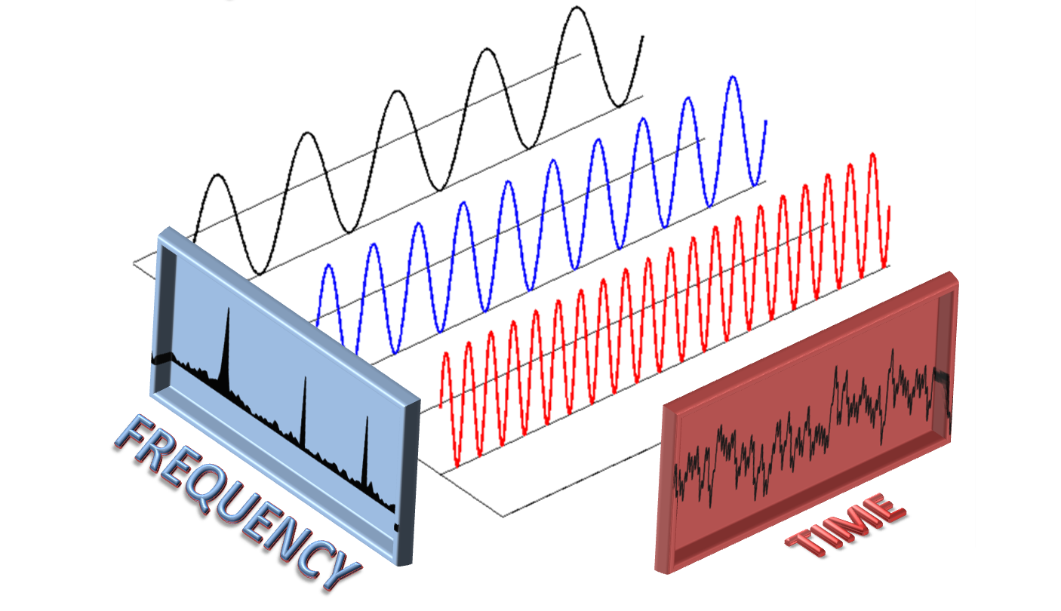
What is a Fourier Transform?
An algorithm to transform time domain equations into frequency domain equations

Slide 4

Discrete Fourier Transform
Φ_{k}=frequency domain
k=frequency
N=number of samples per second
a_{j}=amplitude for a certain sample

Slide 5
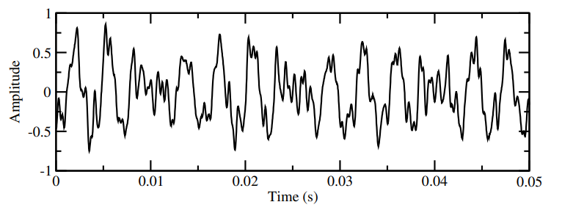
Audio Example
Sound wave of a piano playing a C major chord

Slide 6
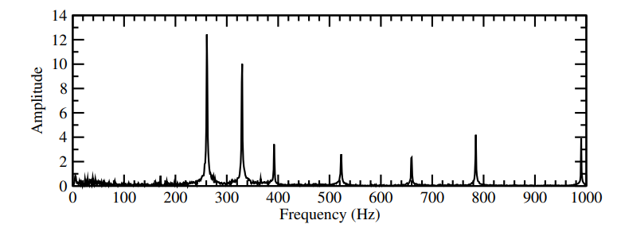
Audio Example
3 main peaks at 262hz, 330hz, and 392hz
Additional peaks for harmonics

Slide 7


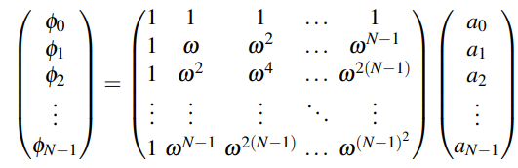
Matrix Fourier Transform
Frequency matrix Amplitude Sample Matrix
Substituting:

Slide 8
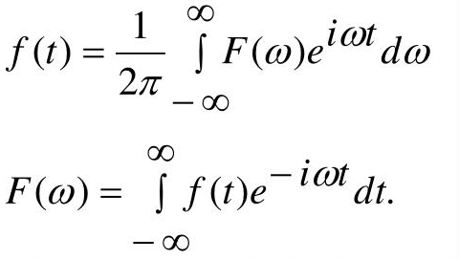
Time Complexity
Discrete Matrix Fourier transform - O(n²)
Fast Fourier transform - O(nlogn)

Slide 9
2
Quantum Fourier Transform
Aidan Westphal

Slide 10
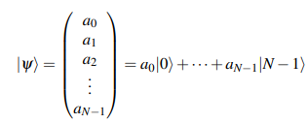
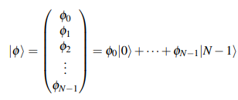

From FFT to QFT
FFT works on the domain of vectors. What is the quantum analogy?
QFT maps between superposition states in the quantum basis.
Mapping function for QFT is the same as FFT.
Notice any similarities?

Slide 11
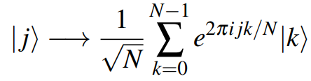
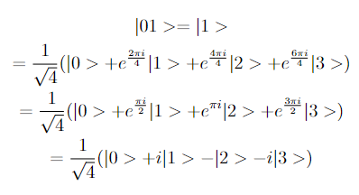
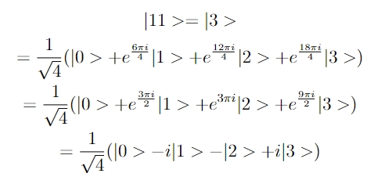
Example: |01>
Shortcut!
Example: |11>

Slide 12
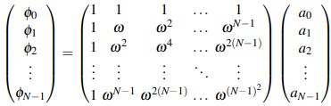

QFT as a Matrix
This is the same format as before, we can represent as a matrix.
Turns out this matrix IS unitary, and thus a Quantum Gate!
Problem: Inefficient… We can do better!

Slide 13
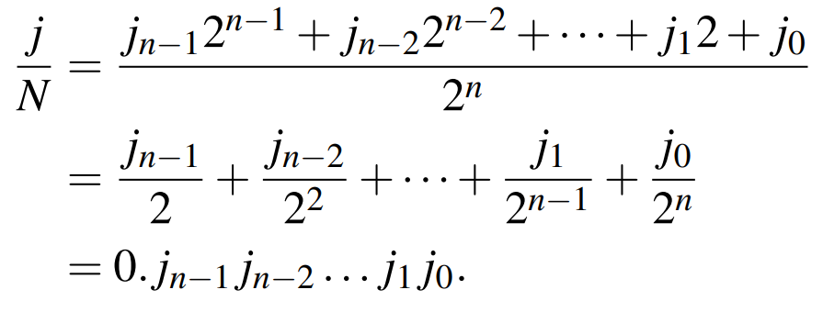
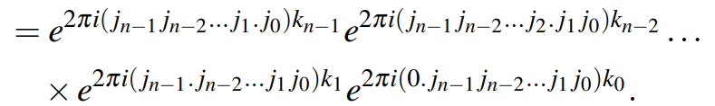

A Binary Solution
For Reference…
We will attempt to find a binary solution for QFT for a basis vector |j>
We can represent j and k as binary numbers in our summation.
Represent j/N as a binary point.
Plug into exponential term.
Note simplifications by means of Euler Identity.

Slide 14
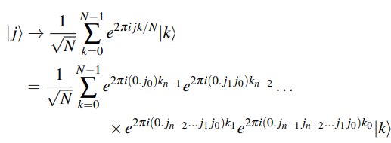
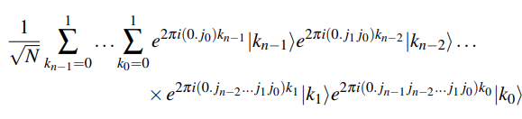
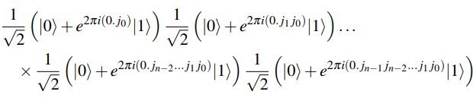
A Binary Solution (Plugging In)
For Reference…
Using the previous simplification we can derive an expression for a QFT qubit.
Put |k> back in its product notion |k_{n-1}>|k_{n-2}>...
We can now distribute summations to each part.
Evaluate each sum as e⁰ = 1
Use N = 2^{n} to further expand the front term:

Slide 15
Visualizing…
As seen in the expansion of |k> the binary decimal shifts over for each term in k
Order is SWAPPED in terms of bits: note how j₀ is only bit in k_{n-1}
Remember binary decimal is shifts in power of 2

Slide 16
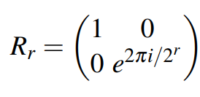
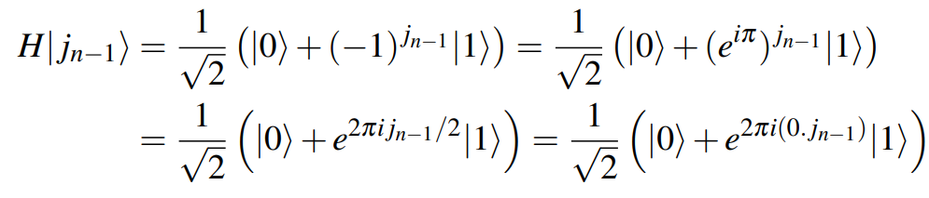
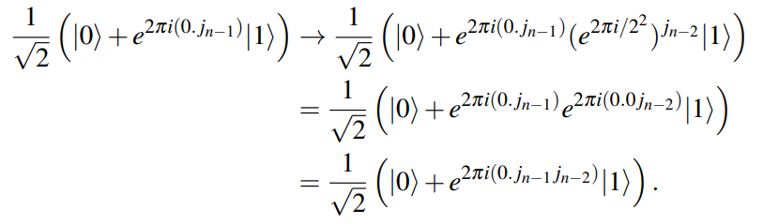
Making a Quantum Circuit
Hadamard gate gives us + or - state, represent as exponential.
Consider a rotation gate by 2pi/2^{r} radians.
How many R_{r} gates do we apply to obtain our desired binary position?
For qubit j_{n-1}:
R₂ applied to qubit j_{n-1} and controlled by j_{n-2}. This adds the 0.0j_{n-2} to decimal.
R₃ applied to qubit j_{n-1} and controlled by j_{n-3}. This adds the 0.00j_{n-3} to decimal.
R_{n} applied to qubit j_{n-1} and controlled by j₀. This adds the 0.0…j₀ to decimal.
Remember this?

Slide 17
Repeated Rotations…
As seen here, H transforms a bit to |+> which has a base exponential term with a binary decimal 0.j_{n-1}.
Series of rotations fill in the rest of the binary decimal.
Steps in a QFT circuit:
Start with j_{n-1} qubit and work towards j₀ (most significant to least significant).
For the j_{k}-th qubit:
Apply an H gate.
Apply rotation gates from R₂ to R_{k+1} in that order, where each is conditioned on one qubit earlier (R₂ on k-1, R₃ on k-2, R_{k+1} on 0)
When done, SWAP the order of all bits (output is reversed).

Slide 18
Why SWAP?
Recall |j> = |j_{n-1}j_{n-2}…j₀> and similar for |k>.
See the final expansion of |k>, in order from k_{n-1} to k₀ qubit states.
Note from last slide that |j_{n-1}> maps to the full expansion of a binary decimal.
This is, in the order above, |k₀>.

Slide 19
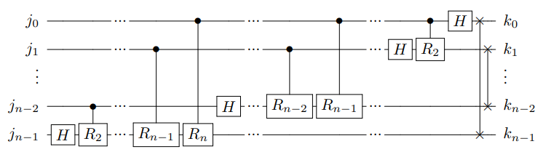
Circuit Diagram

Slide 20
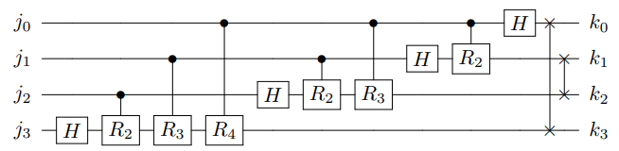
Circuit Diagram Example (4 qubit)
We can imagine how this plays out: |j₃> has H R₂ R₃ and R₄ giving it a binary decimal of 0.j₃j₂j₁j₀ which is then swapped for |k₀> (the MSB of k).

Slide 21
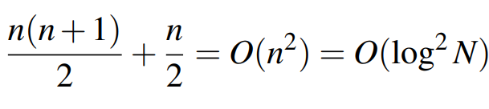
Gate Complexity
For n qubits, the total number of gates is the sum of the numbers 1, 2, …, n.
The sum of this is n(n+1)/2.
We then have n/2 SWAP operations.
In terms of the number of qubits, this is O(n²).
In terms of superposition states (N), 2^{n} = N.
Therefore, in terms of N, this is O(log²N).
This is an exponential speedup from O(NlogN)!

Slide 22
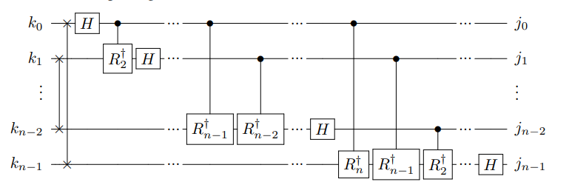
Inverse QFT
Obtained by inverting order of gates AND taking their conjugate transposes.
NOTE: SWAP^{H} = SWAP, H^{H} = H, and R_{r}^{H} is a rotation by -2pi/2^{r} instead of positive.
IQFT has the same Gate Complexity as QFT (O(log²N)).

Slide 23
3
Programming Example and Results
Yi Hung Lim

Slide 24
Google Colab

Slide 25
Works Cited
https://github.com/Qiskit/textbook/blob/main/notebooks/ch-algorithms/quantum-fourier-transform.ipynb
Introduction to Classical and Quantum Computing by Thomas Wong (Class Textbook)

